Slide 1
WHS
Career and Technical
Education

Slide 2
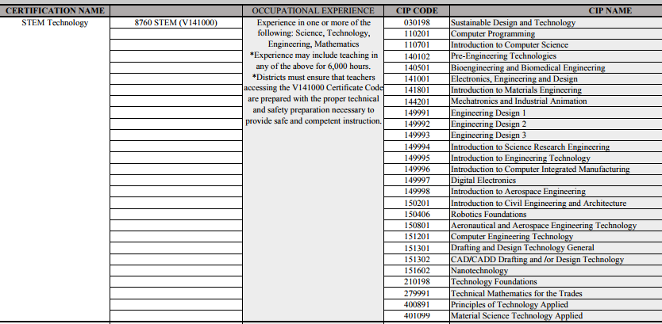
Frameworks
Each CTE Class must have an approved framework.
Each CTE Instructor must have certification (v code) that aligns with the course/framework identification (cip code).
Frameworks must have a leadership component and align with both Washington State Core Standards and 21st Century Skills.

Slide 4
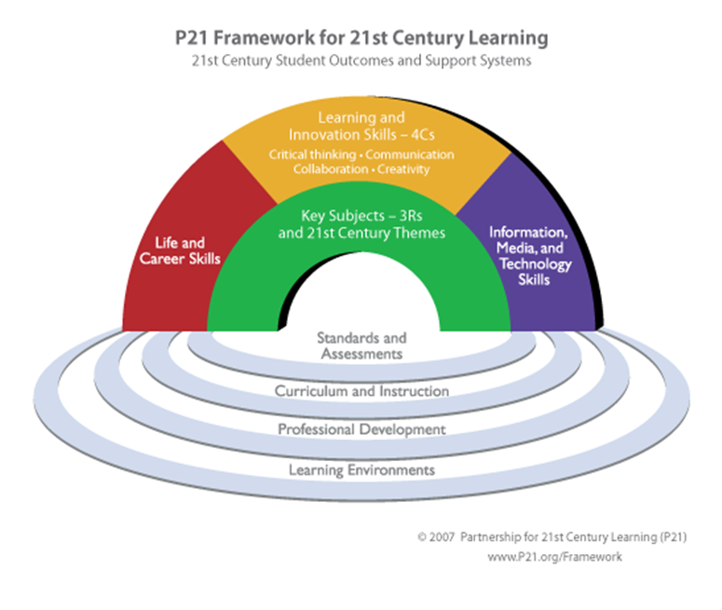
This Framework for 21st Century Learning was developed with input from teachers, education experts, and business leaders to define and illustrate the skills and knowledge students need to succeed in work, life and citizenship, as well as the support systems necessary for 21st century learning outcomes

Slide 5
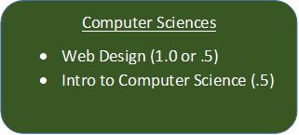
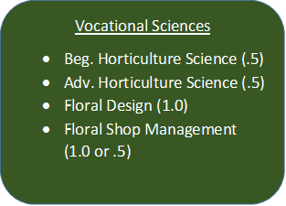
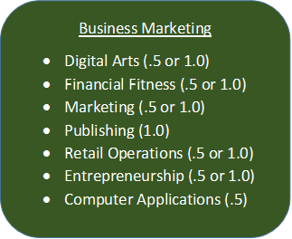
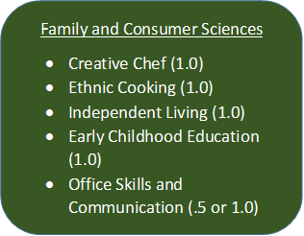
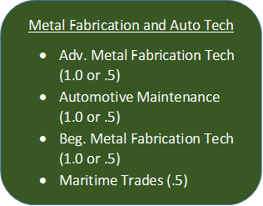
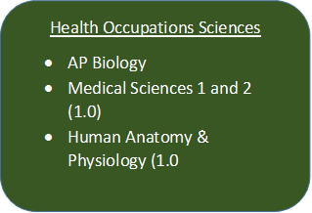
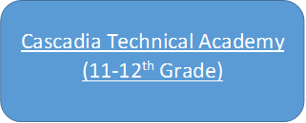

Slide 6
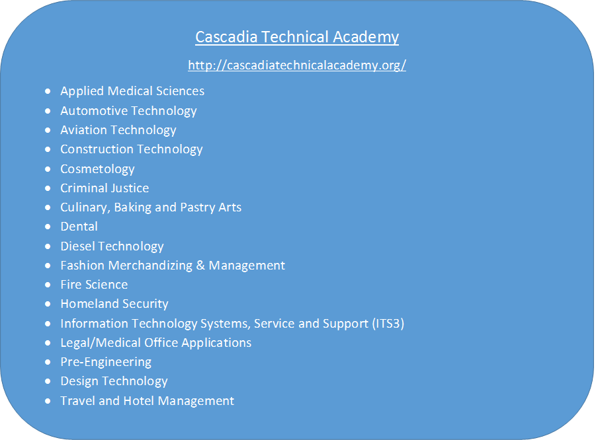

Slide 7
1:2:7

Slide 8
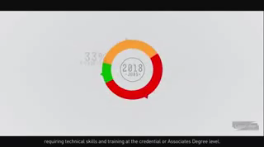

Slide 9
Where we are heading…
Worksite Learning
  A partnership with Partners In Careers
  Summer Internship (2018)
  New WHS Course (2018-19)
Local Advisory
  A partnership between our schools, businesses, community and the STEM Network.
  What skills/tools do our students need to be both college and career ready?
  Expand our cte program by creating new courses that are both relevant and support fields that are in demand.
Pathways
  A sense of purpose for our all of our students.
  Expanded to WMS.

